Slide 1
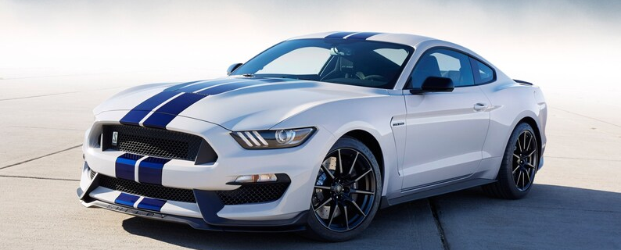
Ford Cars
Price prediction for used cars
Matthew Belizaire, Connor Graff, Tuyen Nguyen, Jen Stone: Introduction to Data Science 6.13.2022

Slide 2
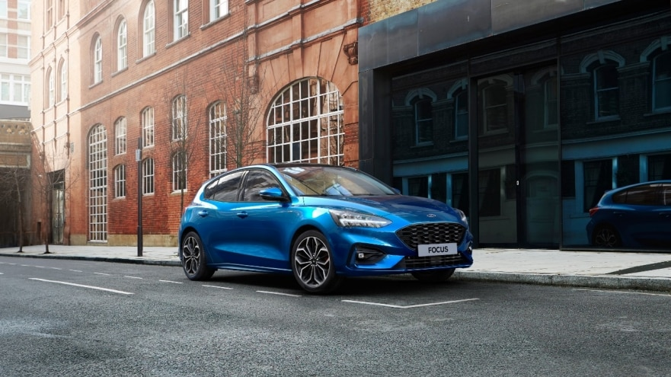
OSEMN
OBTAIN: Project objective, an overview of the datasets we acquired, and data dictionary
SCRUB: Data munging process, challenges and solutions
EXPLORE: Initial modeling and exploratory analysis including
MODEL: Linear modeling to anticipate buyer needs
iNTERPRET: Conclusions, what did we learn?
Notes:
Tuyen

Slide 3

OBTAIN

Slide 4
Objectives
What Buyers Want
What factors affect the price of the vehicle?
What about the MPG and cost of fuel?
How does the buyer get the most “bang for their buck”?
Notes:
Tuyen

Slide 5
About the Ford Car Datasets
The Ford Car Price Prediction Dataset
The Ford Car Price Prediction dataset comes from Kaggle and contains a sample of the different models of used Ford cars, from 1996 to 2020.
There are 9 columns with 17,965 rows of data.
Data Source: https://www.kaggle.com/datasets/adhurimquku/ford-car-price-prediction
The Fuel Economy Dataset
The Fuel Economy dataset comes from fueleconomy.gov and contains information on all models for participating car manufacturers (many more than just Ford) from 1984-2023.
There are 83 columns with 44,889 rows of data.
Data Source: https://www.fueleconomy.gov/feg/download.shtml
The Fuel Economy dataset was included to supplement the Kaggle dataset; it only contains information related to Fuel economy but is incredibly expansive in the topic.
Notes:
Tuyen

Slide 6
Data Dictionary
Kaggle Dataset
model: Model of the car. Same for both datasets
year: Year the car was made. Same for both datasets
price: Current value of the car
transmission: Gear type (e.g., automatic, manual)
mileage: Number of miles traveled
fuelType: Type of fuel the car uses (ex, electric). Same for both datasets
tax: Annual tax on the vehicle
mpg: Average miles per gallon
engineSize: Size of the car’s engine (measured in liters)
.Gov Dataset
city08: MPG car receives driving in the city
combo08: Average MPG car receives between city and highway driving
highway08: MPG car receives driving on the highway
fuelcost08: the annual cost of fuel for the car
Vclass: Vehicle class, e.g., compact car, van, etc
trany: Transmission, or gear type for the .gov set (more detailed than the Kaggle. Includes number of speeds and shifts in addition to manual vs automatic vs semi-auto)
Notes:
Tuyen

Slide 7

SCRUB

Slide 8
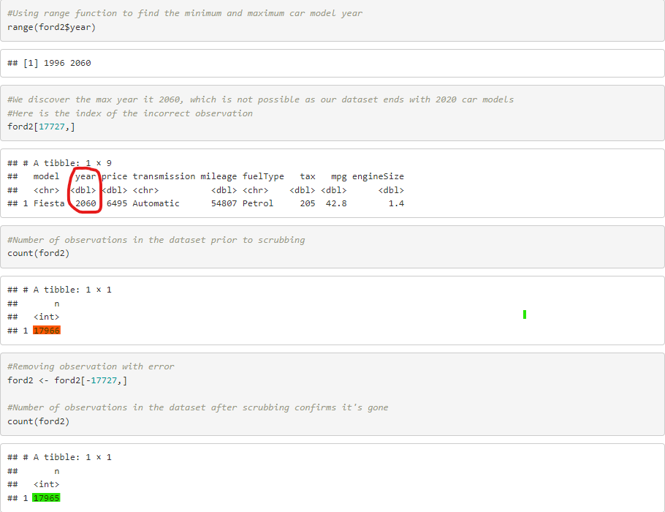
Data Munging, Kaggle
Cleansing the Kaggle Dataset
There were originally 17,966 rows (observations) of data, in comparison to the final 17,965
There was not much that needed to be done…
Discovered an error in the “year” attribute for one of our observations while exploring the data
How we discovered, and solved this error:
Notes:
Jen

Slide 9
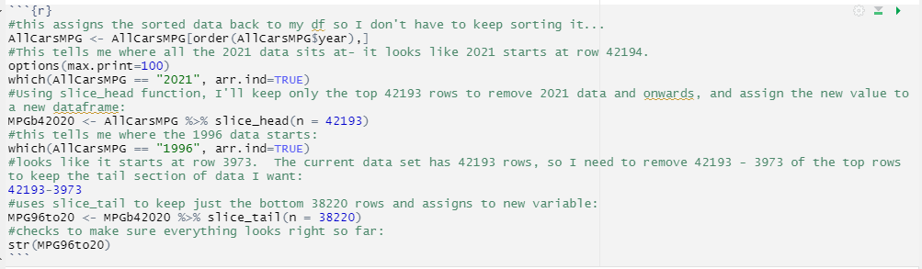
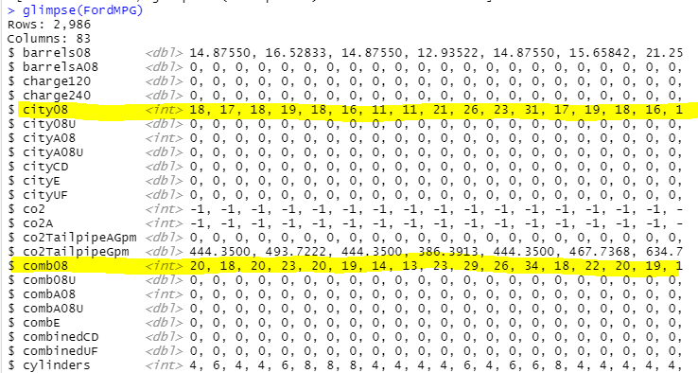
Data Munging, .Gov
As the GOV data is meant to support the Kaggle data, it was important to make the sets more consistent. So:
Slice out dates that do NOT match Kaggle (ie, dates must be 1996- 2020)
Remove all makes that are NOT Ford
Figure out which of the many, many MPG columns to use and just keep the best!
Notes:
Jen

Slide 10
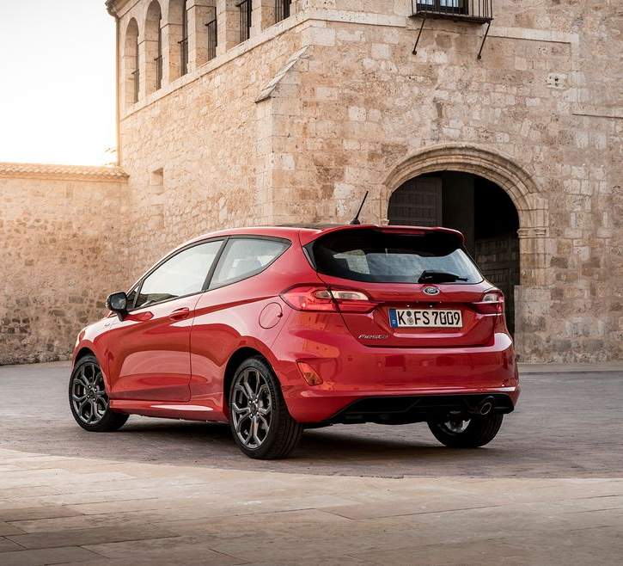
EXPLORE

Slide 11
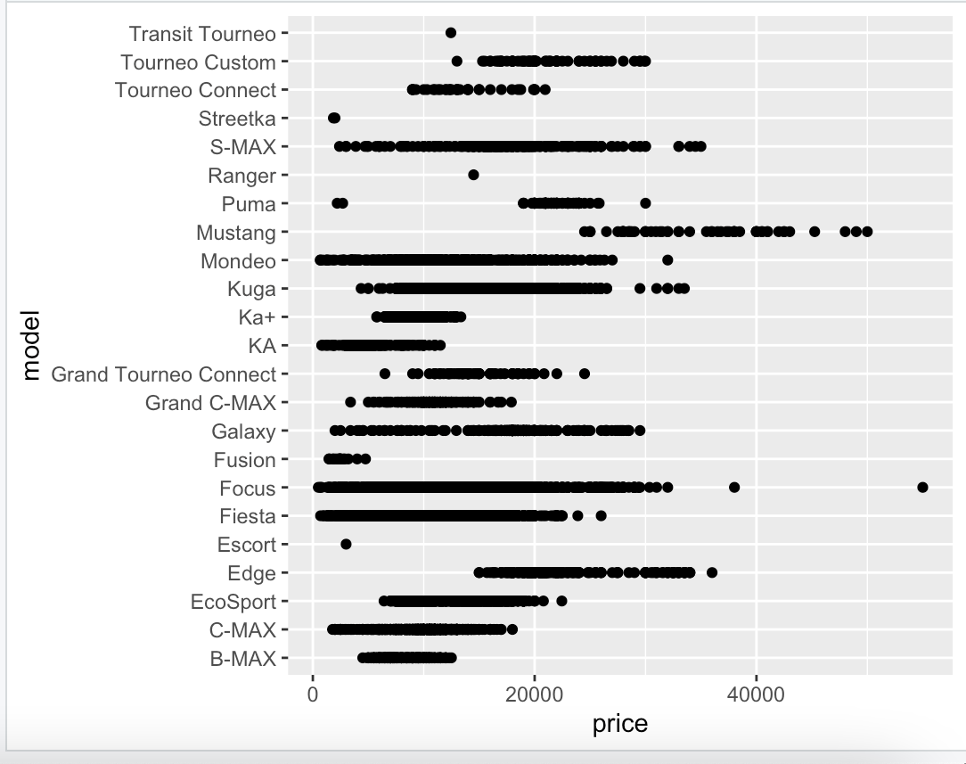
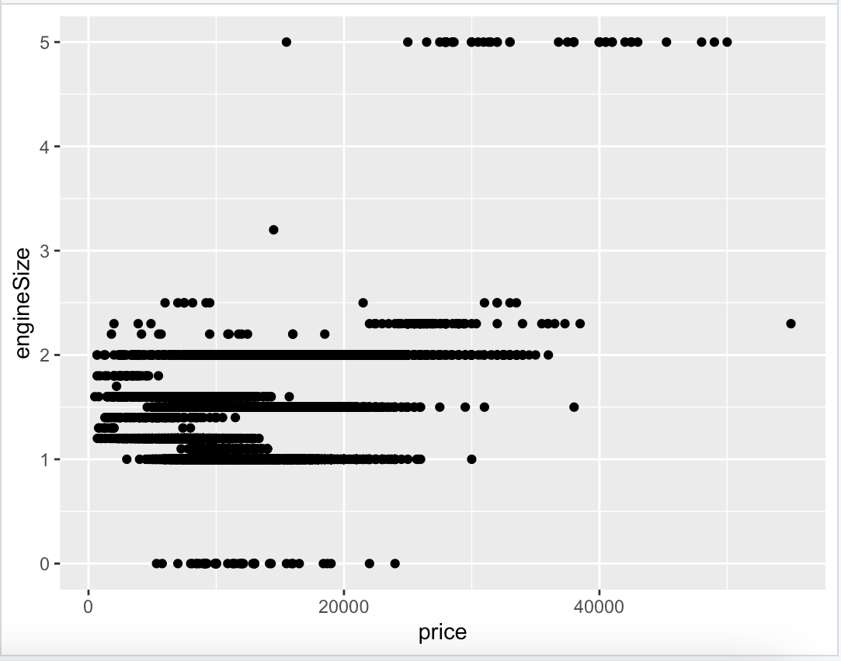
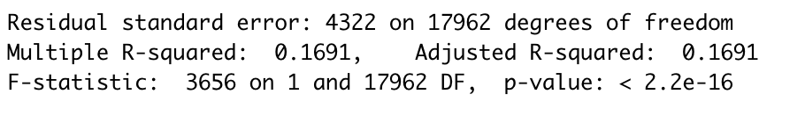
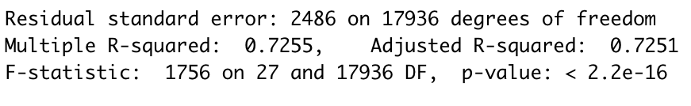
Exploring Price Factors
We ran a couple of scatterplots to determine if model or engine size affected the price… but it was inconclusive. After which, we also ran regressions to verify the data and determine where we should focus our attentions next:
a more accurate LM was found by predicting price based on mileage, model, and fuel type.:
Notes:
Connor

Slide 12
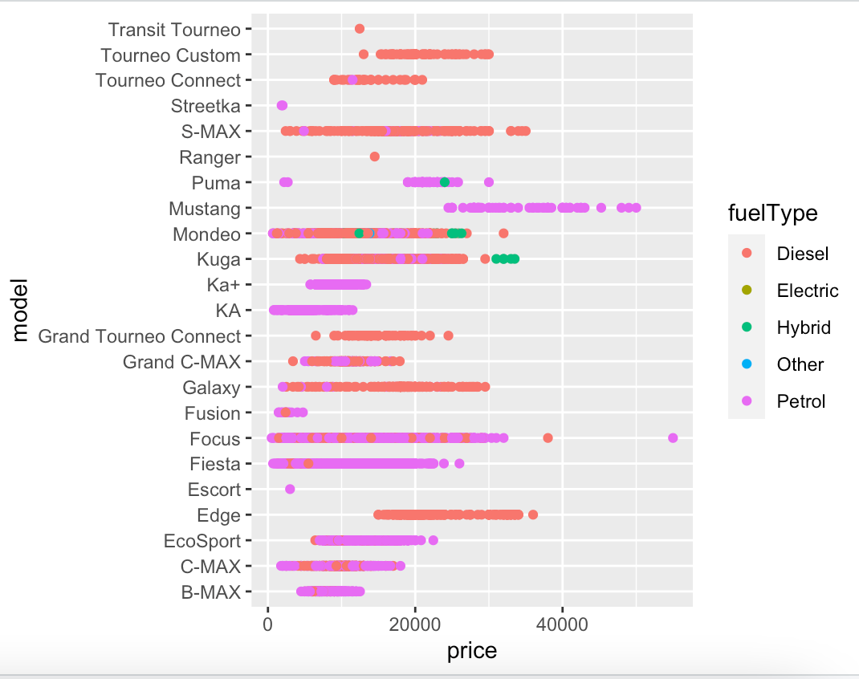
Much better!
Notes:
Connor

Slide 13
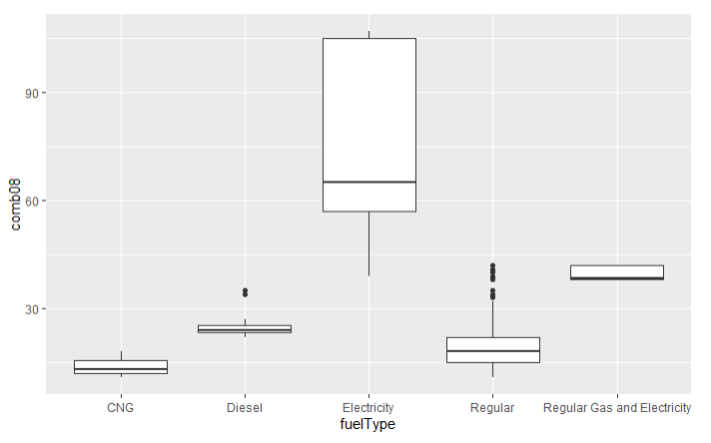
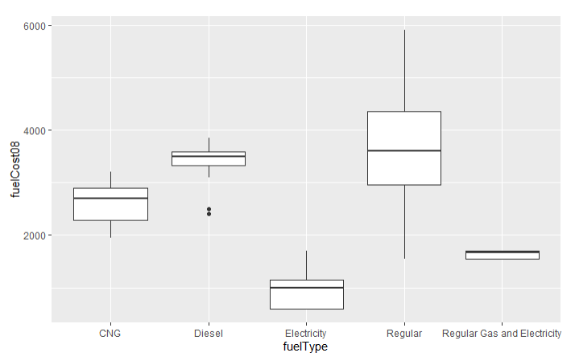
Exploring MPG Factors
On a similar vein to the improved price factor model, we explored how fuel type affects average MPG, as well as the cost of fuel.
Notes:
Jen

Slide 14
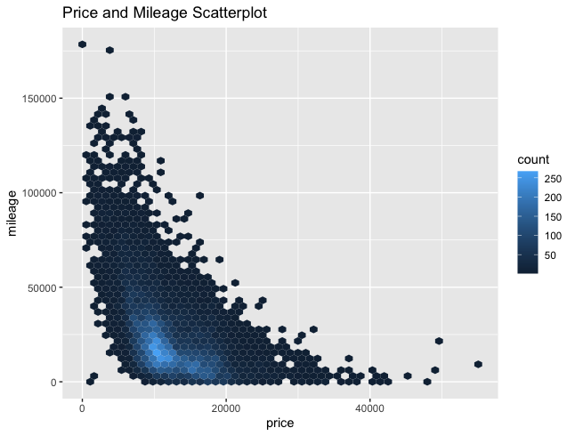
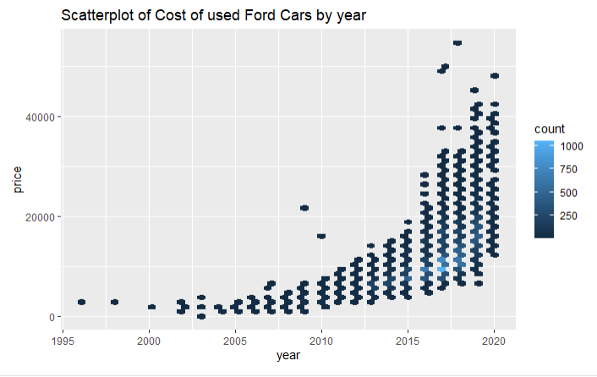
Exploring Price Factors, Cont.
Unsurprisingly, year of vehicle and mileage on the vehicle also definitely play a part in the cost:
Notes:
Matthew

Slide 15
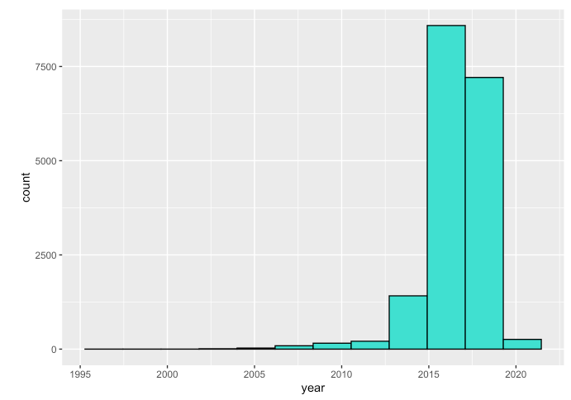
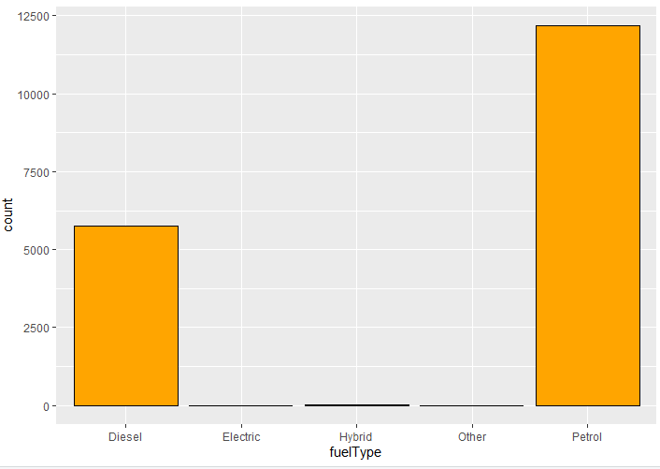
Exploring The Basics
And before we get too far ahead of ourselves in the predictive analytics, keep in mind- the majority of the Kaggle Data is for cars from 2015 to approx 2018, and it’s mostly diesel and petrol!
Notes:
Matthew

Slide 16
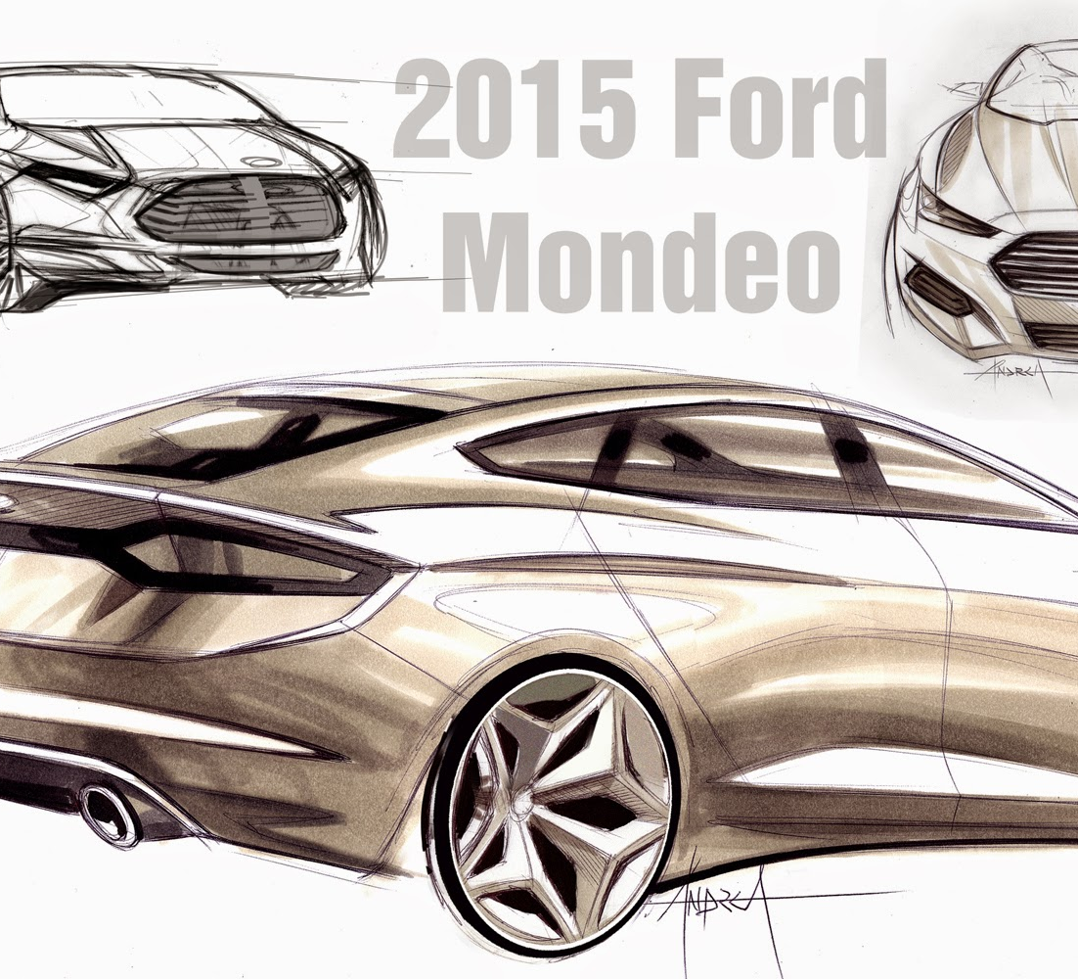
MODEL

Slide 17
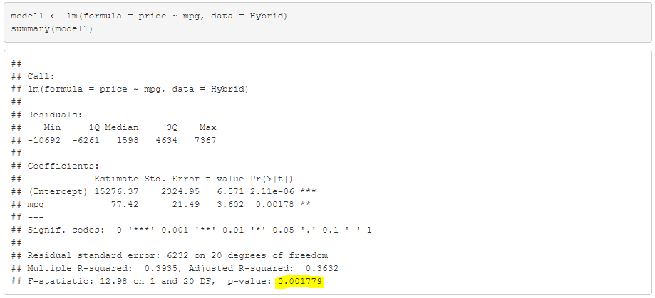
Predictive Analytics: Linear Modeling
Hybrid:
As a continuation on the analysis of the better Price Factor Model (concluding a relationship between price and mileage, model, and fuel type) we ran three different linear models studying the relationship between each of the three main fuel types (Petrol, Hybrid and Diesel, keeping in mind the rarity of electric and natural gas, or “other” fuels)
Notes:
Matthew

Slide 18
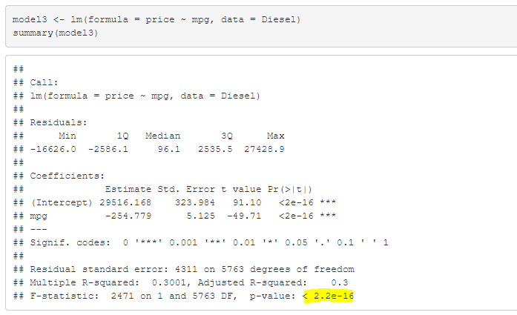
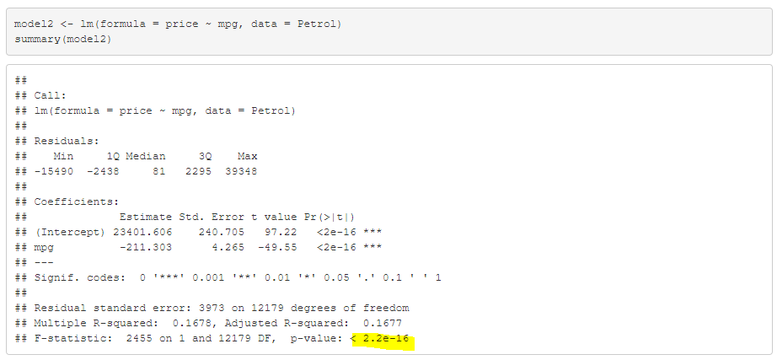
Petrol and Diesel
Notes:
Matthew

Slide 19
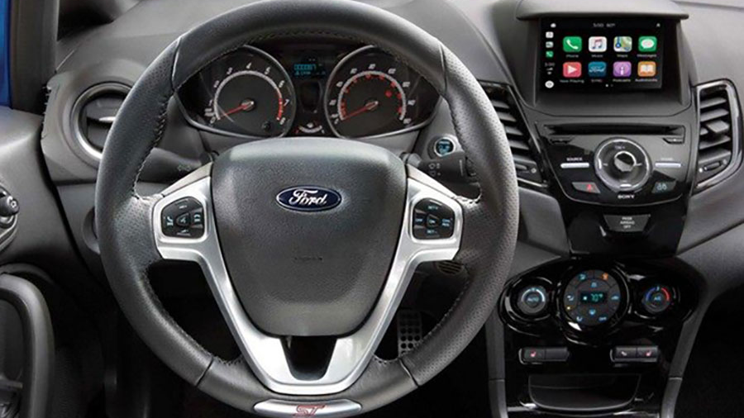
iNTERPRET

Slide 20
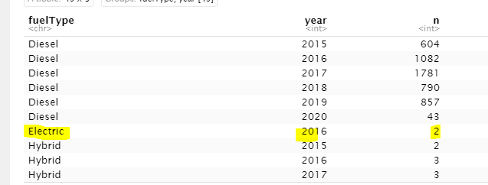
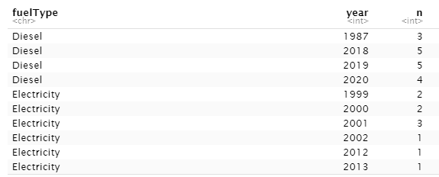
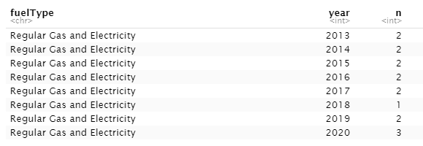
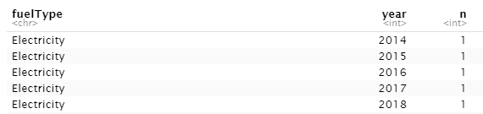

Where are all the Electric Cars…?
In exploring the count of each fuel type, we discovered there was virtually no data on electric, hybrid, or other fuel types in the Kaggle set. This is mirrored by the fuel.gov data, indicating it may not be the Kaggle user’s failure to acquire data on Ford used electric and hybrid cars, but an absence of available data for Ford in the time period:
Kaggle Dataset
.Gov Dataset
Please note: Kaggle counts the number of used vehicles (the cars themselves). The .GOV set does not have multiples of the same make and model; it is counting the number of unique models produced I na year)
Notes:
Jen

Slide 21
What Happened to the Electric Car?
This was a really interesting find, so we did a little digging into the history of the Electric car.
The Electric car has actually been around for a very long time- according to energy.gov, since 1828! They were, in fact, very popular until 1908, when Ford’s Model T introduced a mass produced gas powered car, that unfortunately, resulted in the decline of popularity of electric vehicles… By 1935, due to cheaper gas powered cars and the ready availability of crude oil in Texas, EV’s were basically obsolete. It isn’t until soaring gas prices in the 1970s that companies start looking at electric vehicles again. However, at the time, electric vehicles just aren’t as fast as gas cars, and have a limited distance they can travel, so interest again drops off until the mid 90s. The first mass produced Hybrid doesn’t come into play until 1997- and it comes from Toyota, not Ford. Ford really joins the game again in 1999, when it purchases Th!nk City from a Norwegian company. Th!nk has a range of 53 miles and top speed of 55 MPH – so it’s not bad, but it’s not highway ready – and Ford ditches the product line. In the late 90’s, they try again with the Ranger EV, but this car is 52k and had a number of quality problems after 25,000 miles of use. Ford again ditches the project. Due to the popularity of Toyota’s Prius, Ford tries again with the Focus Electric in 2009. It goes into production by 2011 (you may have noticed the 10 year gap in electric car data in the prior slide). Ford eventually winds up dropping the project in 2018 as the electric batteries are just too expensive for the company. Ford has announced their intention of investing 11$ billion to produce fully electric vehicles by 2022 – including an electric Mustang inspired SUV.
https://www.energy.gov/timeline/timeline-history-electric-car
https://insideevs.com/features/342330/ford-electric-cars-past-present-and-future/
Notes:
Jen

Slide 22
In Conclusion
In Regards to MPG and Cost of Fuel
The lowest fuel costs and the best MPG are, naturally, the Electric and Hybrid vehicles. But good luck finding an Electric or Hybrid Ford in a used car sales lot! Ford Electrics in particular are extremely rare to come by in a used lot!
In Regards to Price
Expect to pay more for certain models over others (stay away from Mustangs if you’re trying to save money!)
Mileage, year, and MPG are also certainly strong factors in predicting the cost of the vehicle. Engine size, however, is not a factor you’ll need to pay more for.
Notes:
Connor

Slide 23

END.

